Slide 1
CPT-S 415
Big Data
Yinghui Wu
EME B45

Slide 2
CPT-S 415
Big Data
Beyond RDBMS
noSQL databases
noSQL: concept and theory
  CAP theory
  ACID vs EASE
  noSQL vs RDBMS
noSQL databases
  Key-value stores
  Column family (next lecture)
Graph databases (next lecture)
Notes:
Object.

Slide 3
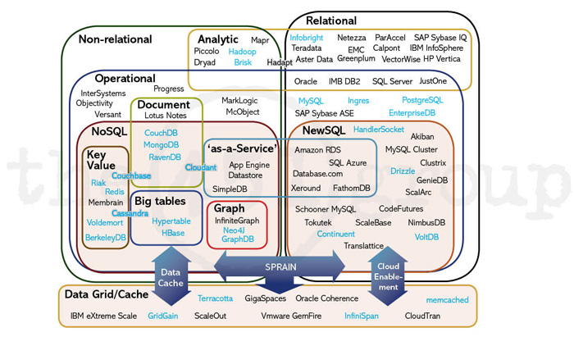


Slide 4
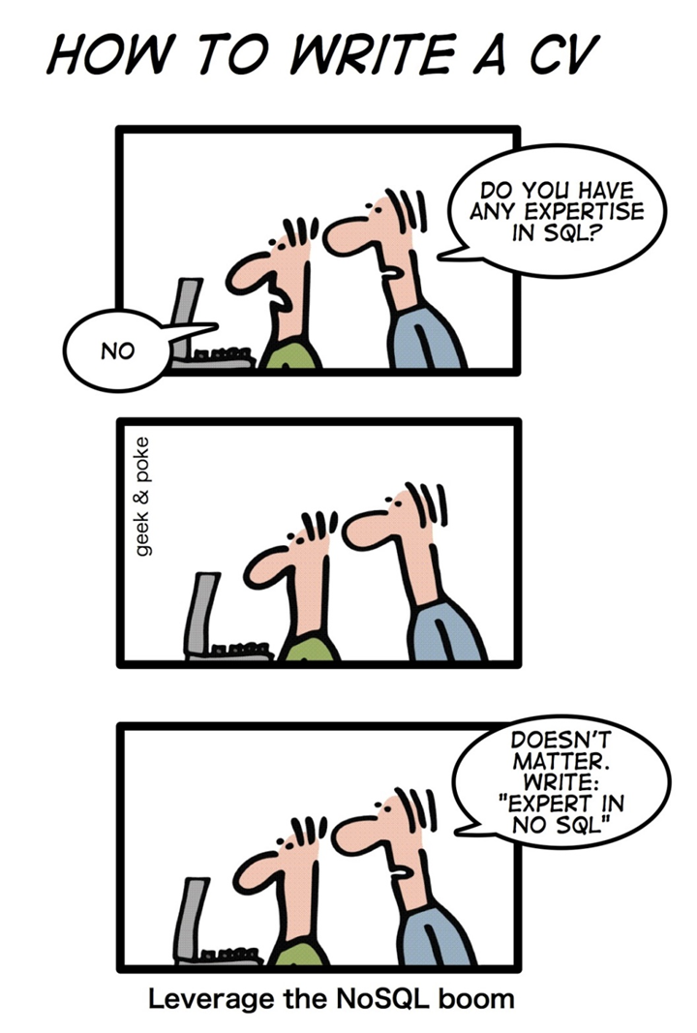
NoSQL: concept
NoSQL is a non-relational database management system, different from traditional RDBMS
Carlo Strozzi used the term NoSQL in 1998 to name his lightweight, open-source relational database that did not expose the standard SQL interface
In 2009, Eric Evans reused the term to refer databases which are non-relational, distributed, and does not conform to ACID
  The NoSQL term should be used as in the Not-Only-SQL and not as No to SQL or Never SQL

Slide 5
Motives Behind NoSQL
Big data.
Scalability.
Data format.
Manageability.

Slide 6
Scalability
Scale up, Vertical scalability.
  Increasing server capacity.
  Adding more CPU, RAM.
  Managing is hard.
  Possible down times
Scale out, Horizontal scalability.
  Adding servers to existing system with little effort, aka Elastically scalable.
  Shared nothing.
  Use of commodity/cheap hardware.
  Heterogeneous systems.
  Controlled Concurrency (avoid locks).
  Service Oriented Architecture.
    Decentralized to reduce bottlenecks.
    Avoid Single point of failures.
  Asynchrony.

Slide 7
CAP theory

Slide 8

CAP Theorem
Also known as Brewer’s Theorem by Prof. Eric Brewer, published in 2000 at UC Berkeley.
http://www.cs.berkeley.edu/~brewer/cs262b-2004/PODC-keynote.pdf
Eric Brewer 2001

Slide 9
CAP Theory
GIVEN:
C
Many nodes
Nodes contain replicas of partitions
of the data
Consistency
  All replicas contain the same version of data
  Client always has the same view of the data (no matter what node)
Availability
  System remains operational on failing nodes
  All clients can always read and write
Partition tolerance
  multiple entry points
  System remains operational on system split (communication malfunction)
  System works well across physical network partitions
A P
CAP Theorem: satisfying all three at the same time is impossible
6

Slide 10
CAP theorem
“Of three properties of a shared data system: data consistency, system availability and tolerance to network partitions, only two can be achieved at any given moment.”
Proven by Nancy Lynch et al. MIT labs.
What the CAP theorem really says:
If you cannot limit the number of faults and requests can be directed to any server and you insist on serving every request you receive then you cannot possibly be consistent
How it is interpreted:
You must always give something up: consistency, availability or tolerance to failure and reconfiguration

Slide 11
Proof: a trivial two-node system
App
Data
Data
A
B

Slide 12
A Simple Proof
Available and partitioned
Not consistent, we get back old data.
App
Data
Old Data
A
B
Notes:
Messages can’t get through: 3 cases:
Older version returned - > not consistent
If want to make sure?

Slide 13
A Simple Proof
Consistent and partitioned
Not available, waiting…
App
New Data
Wait for new data
A
B
Notes:
If we want to guarantee consistency, we have to wait. If messages can’t get through. Not available.

Slide 14
A Simple Proof
Consistent and Available
No partition.
App
Data
Data
A
B
Notes:
What if messages can get through? Now can be consistent and available. But depend on network not being partitioned. Hence not partition tolerant.

Slide 15
Where would SQL lie on this triangle?
C
SQL
RDBMS
A P

Slide 16
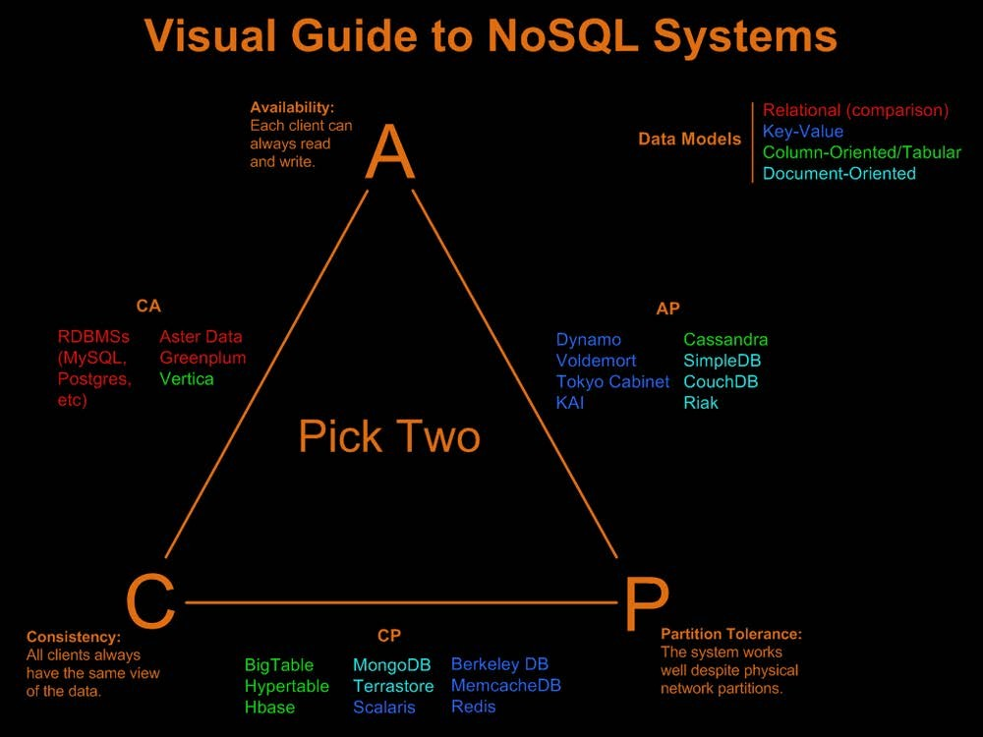
Consistent, Available (CA) Systems have trouble with partitions
and typically deal with it with replication
Available, Partition- Tolerant (AP) Systems achieve "eventual consistency" through replication and verification
Consistent, Partition-Tolerant (CP) Systems have trouble with availability while keeping data consistent across partitioned nodes
http://blog.nahurst.com/visual-guide-to-nosql-systems

Slide 17
Consistency: ACID vs BASE

Slide 18
ACID
Databases require 4 properties:
Atomicity: When an update happens, it is “all or nothing”
Consistency: The state of various tables much be consistent (relations, constraints) at all times.
Isolation: Concurrent execution of transactions produces the same result as if they occurred sequentially.
Durability: Once committed, the results of a transaction persist against various problems like power failure etc.
These properties ensure that data is protected even with complex updates and system failures.
Any data store can achieve Atomicity, Isolation and Durability but do you always need consistency? No.
By giving up ACID properties, one can achieve higher performance and scalability.
Notes:
These properties ensure that data is protected even with complex updates and system failures.
Any data store can achieve Atomicity, Isolation and Durability but do you always need consistency? No.
By giving up ACID properties, one can achieve higher performance and scalability.
A: a transaction either commit or fail
C: data read/write
I: any transaction does not come cross the ongoing transaction.
D: if DB says I accept the change, and system fails, then the change will be there after the system is restored.

Slide 19
BASE Transactions
Acronym contrived to be the opposite of ACID
  Basically Available,
  Soft state,
  Eventually Consistent
Characteristics
  Weak consistency – stale data OK
  Availability first
  Best effort
  Approximate answers OK
  Simpler and faster
Notes:
BA: the system does guarantee the availability of the data as regards CAP Theorem;
there will be a response to any request. But, that response could still be ‘failure’ to obtain the requested data or the data may
be in an inconsistent or changing state, much like waiting for a check to clear in your bank account.
Soft state: The state of the system could change over time, so even during times without input there
may be changes going on due to ‘eventual consistency,’ thus the state of the system is always ‘soft.’
Eventual consistency: The system will eventually become consistent once it stops receiving input.
The data will propagate to everywhere it should sooner or later, but the system will continue
to receive input and is not checking the consistency of every transaction before it
moves onto the next one.

Slide 20
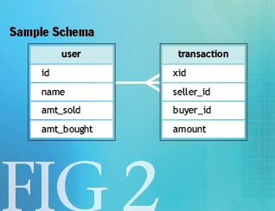
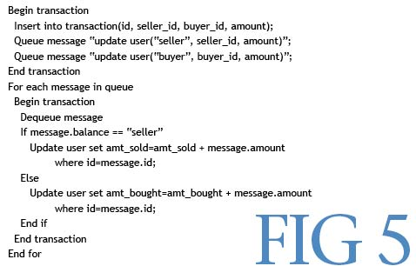
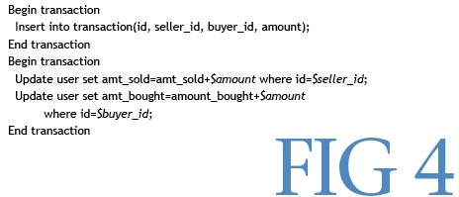
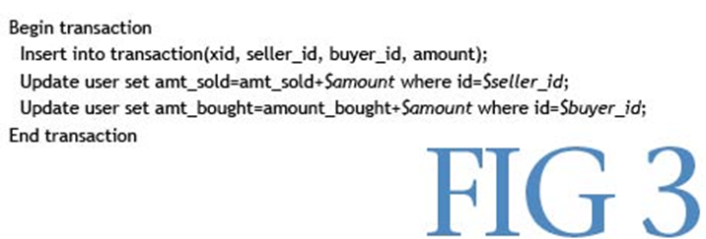
A toy example
Pritchett, D.:
BASE: An Acid Alternative
(queue.acm.org/detail.cfm?id=1394128)

Slide 21
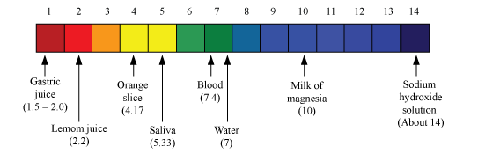
RDB ACID to NoSQL BASE
Pritchett, D.: BASE: An Acid Alternative (queue.acm.org/detail.cfm?id=1394128)
Atomicity
Basically
Data constraints
Smaller,
Schema-driven,
Normalized,
Relational,
Pre-social network
Available
Unstructured data
Big data
Non-relational,
Schema-less,
Distributed,
open-linked data
Consistency
Soft-state
Isolation
(State of system may change
over time)
Durability
Eventually consistent
(Asynchronous propagation)
Vertica
CouchDB
RDBMS (mySQL)
BigTable
HBase
Cassandra
MongoDB
Dynamo

Slide 22
A Clash of cultures
  ACID:
  Strong consistency.
  Less availability.
  Pessimistic concurrency.
  Complex.
  BASE:
  Availability is the most important thing. Willing to sacrifice for this (CAP).
  Weaker consistency (Eventual).
  Best effort.
  Optimistic.
  Simple and fast.

Slide 23
noSQL data models

Slide 24
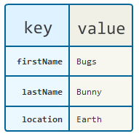
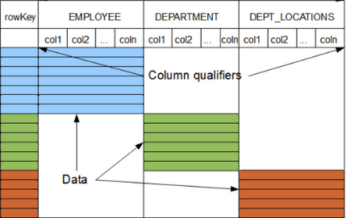
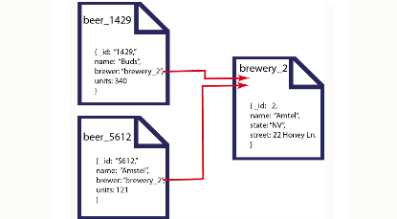
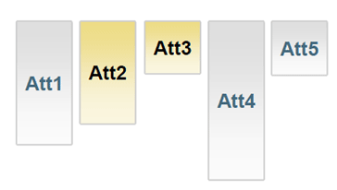
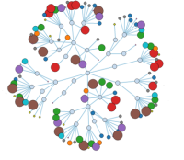
noSQL Data Models
Key/Value Pairs
Row/tabular
Columns
Documents
Graphs
and correspondingly…

Slide 25








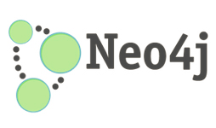
Categories of NoSQL storages
Key-Value
  memcached
  Redis
  Dynamo
Tabular
  BigTable, HBase
Column Family
  Cassandra
Document-oriented
  MongoDB
Graph (beyond noSQL)
  Neo4j
  TITAN

Slide 26
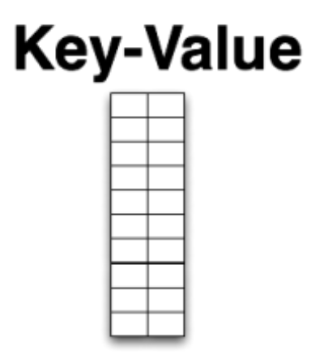
Key-Value Stores
“Dynamo: Amazon’s Highly Available Key-Value Store” (2007)
Data model:
  Global key-value mapping
  Highly fault tolerant (typically)
Examples:
  Riak, Redis, Voldemort
Notes:
History – Amazon decide that they always wanted the shopping basket to be available, but couldn’t take a chance on RDBMS
So they built their own
Big risk, but simple data model and well-known computing science underpinning it (e.g. consistent hashing, Bloom filters for sensible replication)
+ Massive read/write scale
- Simplistic data model moves heavy lifting into the app tier (e.g. map reduce)

Slide 27
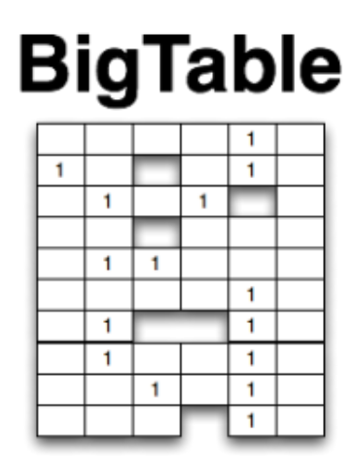
Column Family (BigTable)
Google’s “Bigtable: A Distributed Storage System for Structured Data” (2006)
Data model:
  A big table, with column families
  Map-reduce for querying/processing
Examples:
  HBase, HyperTable, Cassandra

Slide 28
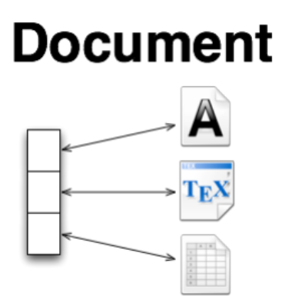
Document Databases
Data model
  Collections of documents
  A document is a key-value collection
  Index-centric, lots of map-reduce
Examples
  CouchDB, MongoDB

Slide 29
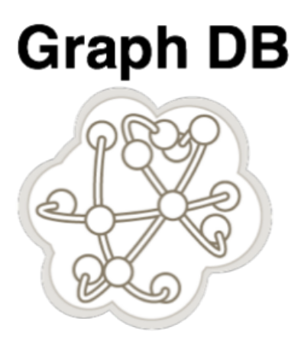
Graph Databases
Data model:
  Nodes with properties
  Named relationships with properties
  Hypergraph, sometimes
Examples:
  Neo4j, Sones GraphDB, OrientDB, InfiniteGraph, AllegroGraph
Notes:
People talk about Codd’s relational model being mature because it was proposed in 1969 – 42 years old.
Euler’s graph theory was proposed in 1736 – 275 years old.

Slide 30
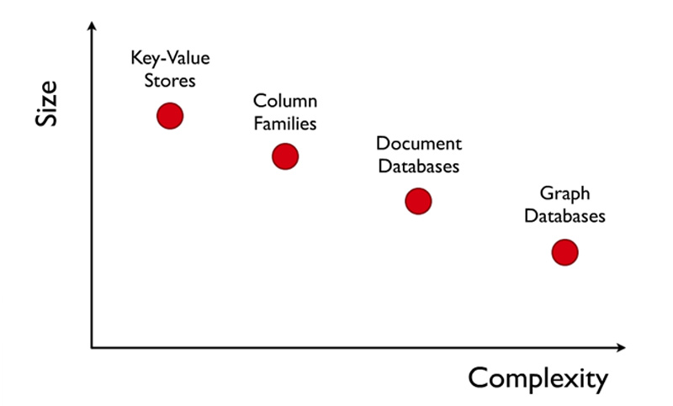
Complexity
still billions of
Nodes
&relationships
90% of use cases

Slide 31
Key-value store

Slide 32
KV-stores and Relational Tables
KV-stores seem very simple. They can be viewed as two-column (key, value) tables with a single key column.
But they can be used to implement more complicated relational tables:
State | ID | Population | Area | Senator_1
Alabama | 1 | 4,822,023 | 52,419 | Sessions
Alaska | 2 | 731,449 | 663,267 | Begich
Arizona | 3 | 6,553,255 | 113,998 | Boozman
Arkansas | 4 | 2,949,131 | 53,178 | Flake
California | 5 | 38,041,430 | 163,695 | Boxer
Colorado | 6 | 5,187,582 | 104,094 | Bennet
… | …
Index

Slide 33
KV-stores and Relational Tables
The KV-version of the previous table includes one table indexed by the actual key, and others by an ID.
State | ID
Alabama | 1
Alaska | 2
Arizona | 3
Arkansas | 4
California | 5
Colorado | 6
… | …
ID | Population
1 | 4,822,023
2 | 731,449
3 | 6,553,255
4 | 2,949,131
5 | 38,041,430
6 | 5,187,582
… | …
ID | Area
1 | 52,419
2 | 663,267
3 | 113,998
4 | 53,178
5 | 163,695
6 | 104,094
… | …
ID | Senator_1
1 | Sessions
2 | Begich
3 | Boozman
4 | Flake
5 | Boxer
6 | Bennet
… | …

Slide 34
KV-stores and Relational Tables
We can add indices with new KV-tables:
Thus KV-tables are used for column-based storage, as opposed to row-based storage typical in older DBMS.
…
OR: the value field can contain complex data
State | ID
Alabama | 1
Alaska | 2
Arizona | 3
Arkansas | 4
California | 5
Colorado | 6
… | …
ID | Population
1 | 4,822,023
2 | 731,449
3 | 6,553,255
4 | 2,949,131
5 | 38,041,430
6 | 5,187,582
… | …
Senator_1 | ID
Sessions | 1
Begich | 2
Boozman | 3
Flake | 4
Boxer | 5
Bennet | 6
… | …
Index
Index_2

Slide 35






Key-Values: Examples
Amazon:
  Key: customerID
  Value: customer profile (e.g., buying history, credit card, ..)
Facebook, Twitter:
  Key: UserID
  Value: user profile (e.g., posting history, photos, friends, …)
iCloud/iTunes:
  Key: Movie/song name
  Value: Movie, Song
Distributed file systems
  Key: Block ID
  Value: Block

Slide 36

System Examples
Google File System, Hadoop Dist. File Systems (HDFS)
Amazon
  Dynamo: internal key value store used to power Amazon.com (shopping cart)
  Simple Storage System (S3)
BigTable/HBase/Hypertable: distributed, scalable data storage
Cassandra: “distributed data management system” (Facebook)
Memcached: in-memory key-value store for small chunks of arbitrary data (strings, objects)
eDonkey/eMule: peer-to-peer sharing system

Slide 37
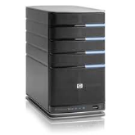
Key-Value Store
Also called a Distributed Hash Table (DHT)
Main idea: partition set of key-values across many machines
key, value
…

Slide 38




Challenges
…
Fault Tolerance: handle machine failures without losing data and without degradation in performance
Scalability:
  Need to scale to thousands of machines
  Need to allow easy addition of new machines
Consistency: maintain data consistency in face of node failures and message losses
Heterogeneity (if deployed as peer-to-peer systems):
  Latency: 1ms to 1000ms
  Bandwidth: 32Kb/s to several GB/s

Slide 39
Key Operators
put(key, value): where do you store a new (key, value) tuple?
get(key): where is the value associated with a given “key” stored?
And, do the above while providing
  Fault Tolerance
  Scalability
  Consistency

Slide 40
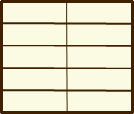
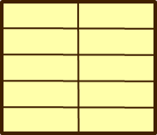
Directory-Based Architecture
Have a node maintain the mapping between keys and the machines (nodes) that store the values associated with the keys
Master/Directory
put(K14, V14)
K5
N2
K14
N3
K105
N50
put(K14, V14)
K5
V5
K14
V14
K105
V105
…
N₁
N₂
N₃
N₅₀

Slide 41
Directory-Based Architecture
Have a node maintain the mapping between keys and the machines (nodes) that store the values associated with the keys
Master/Directory
get(K14)
K5
N2
V14
K14
N3
K105
N50
get(K14)
V14
K5
V5
K14
V14
K105
V105
…
N₁
N₂
N₃
N₅₀
Having the master relay the requests ： recursive query

Slide 42
Directory-Based Architecture
Another method: iterative query (this slide)
  Return node to requester and let requester contact node
put(K14, V14)
K5
N2
N3
K14
N3
K105
N50
put(K14, V14)
Master/Directory
K5
V5
K14
V14
K105
V105
…
N₁
N₂
N₃
N₅₀

Slide 43
Directory-Based Architecture
Another method: iterative query
  Return node to requester and let requester contact node
get(K14)
N3
K5
N2
K14
N3
V14
K105
N50
get(K14)
Master/Directory
K5
V5
K14
V14
K105
V105
…
N₁
N₂
N₃
N₅₀

Slide 44








Iterative vs. Recursive Query
Master/Directory
Master/Directory
get(K14)
get(K14)
V14
K14
N3
N3
K14
N3
V14
get(K14)
get(K14)
Recursive
V14
Iterative
K14
V14
K14
V14
…
…
N1
N2
N3
N50
N1
N2
N3
N50
Recursive Query:
  Advantages:
    Faster (latency), as typically master/directory closer to nodes
    Easier to maintain consistency, as master/directory can serialize puts()/gets()
  Disadvantages: scalability bottleneck, as all “Values” go through master/directory
Iterative Query
  Advantages: more scalable
  Disadvantages: slower (latency), harder to enforce data consistency

Slide 45
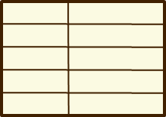
Fault Tolerance
Replicate value on several nodes
Usually, place replicas on different racks in a datacenter to guard against rack failures
put(K14, V14)
K5
N2
N1, N3
K14
N1,N3
K105
N50
put(K14, V14)
put(K14, V14), N1
Master/Directory
K14
V14
K5
V5
K14
V14
K105
V105
…
N₁
N₂
N₃
N₅₀

Slide 46
Fault Tolerance
Again, we can have
  Recursive replication (previous slide)
  Iterative replication (this slide)
put(K14, V14)
K5
N2
N1, N3
K14
N1,N3
K105
N50
put(K14, V14)
put(K14, V14)
Master/Directory
K14
V14
K5
V5
K14
V14
K105
V105
…
N₁
N₂
N₃
N₅₀

Slide 47
Consistency
How close does a distributed system emulate a single machine in terms of read and write semantics?
Q: Assume put(K14, V14’) and put(K14, V14’’) are concurrent, what value ends up being stored?
Q: Assume a client calls put(K14, V14) and then get(K14), what is the result returned by get()?
Above semantics, not trivial to achieve in distributed systems

Slide 48
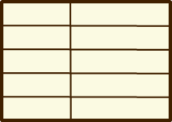

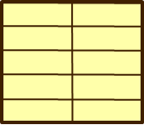
Concurrent Writes (Updates)
If concurrent updates (i.e., puts to same key) may need to make sure that updates happen in the same order
Master/Directory
put(K14, V14’)
put(K14, V14’) and put(K14, V14’’) reach N1 and N3 in different order
What does get(K14) return?
  Undefined!
K5
N2
put(K14, V14’’)
K14
N1,N3
K105
N50
put(K14, V14’’)
put(K14, V14’)
K14
K14
V14
V14’’
K5
V5
K14
K14
V14
V14’
K105
V105
…
N₁
N₂
N₃
N₅₀

Slide 49
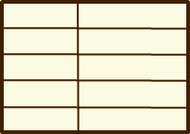
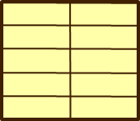
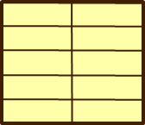
Concurrent Writes (Updates)
If concurrent updates (i.e., puts to same key) may need to make sure that updates happen in the same order
Master/Directory
put(K14, V14’)
put(K14, V14’) and put(K14, V14’’) reach N1 and N3 in different order
What does get(K14) return?
  Undefined!
K5
N2
put(K14, V14’’)
K14
N1,N3
K105
N50
put(K14, V14’’)
put(K14, V14’)
put(K14, V14’’)
put(K14, V14’)
K14
K14
V14’
V14
K5
V5
K14
K14
V14’’
V14
K105
V105
…
N₁
N₂
N₃
N₅₀

Slide 50
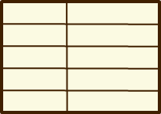
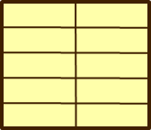
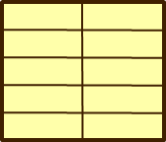
Read after Write
Read not guaranteed to return value of latest write
  Can happen if Master processes requests in different threads
Master/Directory
get(K14) happens right after put(K14, V14’)
get(K14) reaches N3 before put(K14, V14’)!
put(K14, V14’)
K5
N2
get(K14)
K14
N1,N3
V14
K105
N50
put(K14, V14’)
V14
put(K14, V14’)
get(K14, V14’)
K14
K14
V14’
V14
K5
V5
K14
K14
V14’
V14
K105
V105
…
N₁
N₂
N₃
N₅₀

Slide 51
Quorum Consensus
Improve put() and get() operation performance
Define a replica set of size N
put() waits for acks from at least W replicas
get() waits for responses from at least R replicas
W+R > N
Why does it work?
  There is at least one node that contains the update

Slide 52
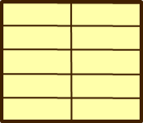
Quorum Consensus Example
N=3, W=2, R=2
Replica set for K14: {N1, N3, N4}
Assume put() on N3 fails
put(K14, V14)
put(K14, V14)
put(K14, V14)
ACK
ACK
K14
V14
K14
V14
N₁
N₂
N₃
N₄

Slide 53
Quorum Consensus Example
Now, issuing get() to any two nodes out of three will return the answer
get(K14)
get(K14)
V14
nill
K14
V14
K14
V14
N₁
N₂
N₃
N₄

Slide 54
Scalability
Storage: use more nodes
Request Throughput:
  Can serve requests from all nodes on which a value is stored in parallel
  Large “values” can be broken into blocks (HDFS files are broken up this way)
  Master can replicate a popular value on more nodes
Master/directory scalability:
  Replicate it
  Partition it, so different keys are served by different masters/directories
Notes:
You can fetch the pieces of a large HDFS file in parallel

Slide 55
Scalability: Load Balancing
Directory keeps track of the storage availability at each node
  Preferentially insert new values on nodes with more storage available
What happens when a new node is added?
  Move values from the heavy loaded nodes to the new node
What happens when a node fails?
  Need to replicate values from failed node to other nodes

Slide 56
Replication Challenges
Need to make sure that a value is replicated correctly
How do you know a value has been replicated on every node?
  Wait for acknowledgements from every node
What happens if a node fails during replication?
  Pick another node and try again
What happens if a node is slow?
  Slow down the entire put()? Pick another node
In general, with multiple replicas
  Slow puts and fast gets

Slide 57
Summary: Key-Value Store
Very large scale storage systems
Two operations
  put(key, value)
  value = get(key)
Challenges
  Fault Tolerance → replication
  Scalability → serve get()’s in parallel; replicate/cache hot tuples
  Consistency → quorum consensus to improve put/get performance
System case study: Dynamo

Slide 58
Key-value store case study: Dynamo

Slide 59
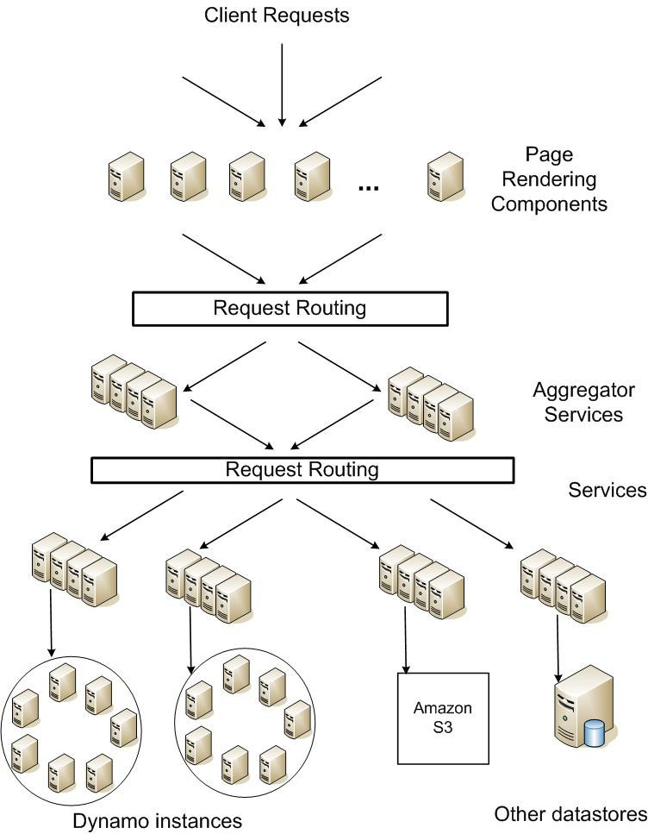
Amazon’s platform architecture

Slide 60
System Assumptions and Requirements
simple read and write operations to a data item that is uniquely identified by a key.
Most of Amazon’s services can work with this simple query model and do not need any relational schema.
targeted applications - store objects that are relatively small (usually less than 1 MB)
Dynamo targets applications that operate with weaker consistency (the “C” in ACID) if this results in high availability.

Slide 61
System architecture
Partitioning
High Availability for writes
Handling temporary failures
Recovering from permanent failures
Membership and failure detection

Slide 62
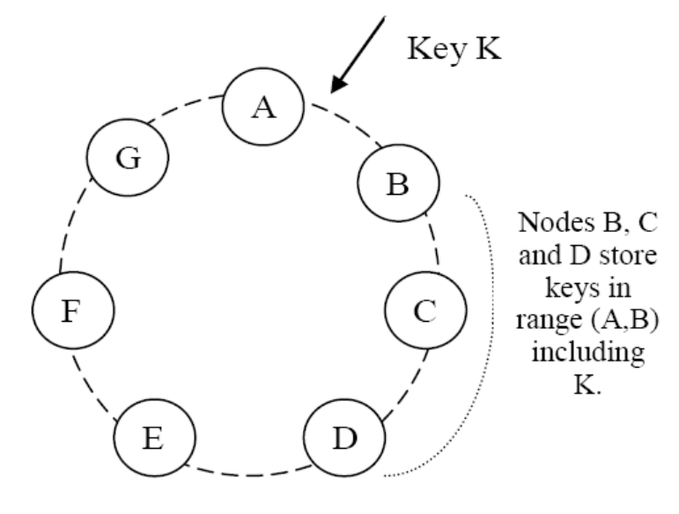
Partition Algorithm
Consistent hashing: the output range of a hash function is treated as a fixed circular space or “ring”.
”Virtual Nodes”: Each node can be responsible for more than one virtual node.
Notes:
Advantages of using virtual nodes:
If a node becomes unavailable，the load handled by this node is evenly dispersed across the remaining available nodes.
When a node becomes available again, or a new node is added to the system, the newly available node accepts a roughly equivalent amount of load from each of the other available nodes.
The number of virtual nodes that a node is responsible can decided based on its capacity, accounting for heterogeneity in the physical infrastructure.

Slide 63
Replication
Each data item is replicated at N hosts.
“preference list”: The list of nodes that is responsible for storing a particular key.

Slide 64
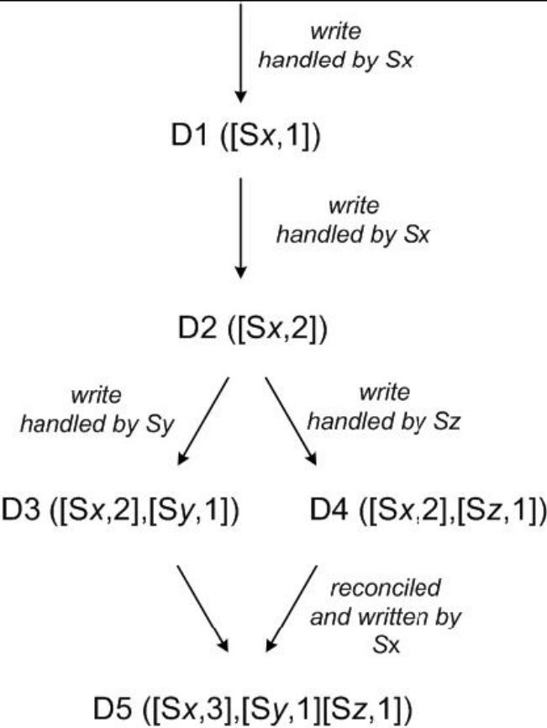
Vector Clock
A vector clock is a list of (node, counter) pairs.
Every version of every object is associated with one vector clock.
If the counters on the first object’s clock are less-than-or-equal to all of the nodes in the second clock, then the first is an ancestor of the second and can be forgotten.
Notes:
In case of network partitions or multiple server failures, write requests may be handled by nodes that are not in the top N nodes in the preference list causing the size of vector clock to grow.
Dynamo stores a timestamp that indicates the last time the node updated the data item.
When the number of (node, counter) pairs in the vector clock reaches a threshold (say 10), the oldest pair is removed from the clock.

Slide 65
Summary of techniques used in
Dynamo and their advantages
Problem | Technique | Advantage
Partitioning | Consistent Hashing | Incremental Scalability
High Availability for writes | Vector clocks with reconciliation during reads | Version size is decoupled from update rates.
Handling temporary failures | Sloppy Quorum and hinted handoff | Provides high availability and durability guarantee when some of the replicas are not available.
Recovering from permanent failures | Anti-entropy using Merkle trees | Synchronizes divergent replicas in the background.
Membership and failure detection | Gossip-based membership protocol and failure detection. | Preserves symmetry and avoids having a centralized registry for storing membership and node liveness information.

